Slide 1


Test automation for WSs

Slide 2

Introduction
Anastasiya Babovich
E-mail: Anastsiya_Babovich@epam.com
Skype: anastasiya_babovich

Slide 3
What we are going to discuss?
SOA
Rest
SOAP
WSDL and WADL
Soap UI
Fiddler
Libraries for WSs

Slide 4
What are not going to discuss?
Technical details in the deep
Implementation details

Slide 5

Service-
Oriented
Architecture

Slide 6
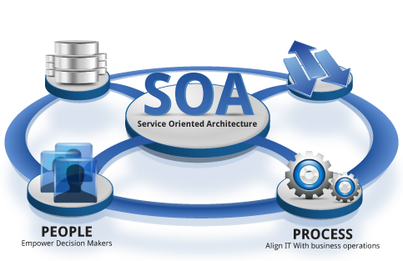
What is SOA?
Service-oriented architecture (SOA) is a flexible set of design principles used during the phases of systems development and integration in computing.
A system based on a SOA will package functionality as a suite of interoperable services that can be used within multiple, separate systems from several business domains.

Slide 7

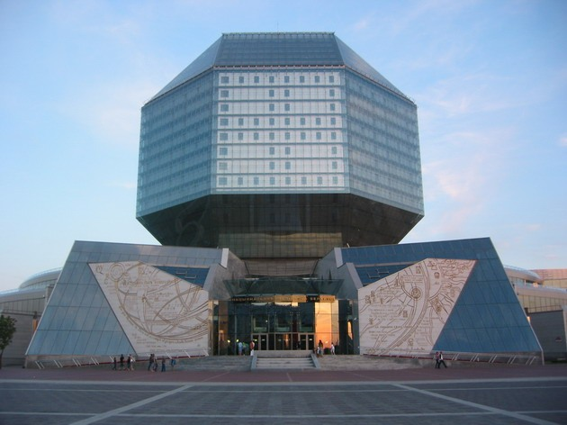

Example of SOA from life
getBook(Pushkin);
setBook(Dostoevski);
removeBook(Tolstoy);

Slide 8

SOA Goals

Slide 9

SOA Goals
Reducing costs when developing applications, due to streamlining the development process;
Improved manageability of systems produced;
Increased scalability posed systems;
Independence of the platform, tools, development languages​​;
Increased code reuse.

Slide 10


Web-
Service

Slide 11

Why do we need Web Services?

Slide 12
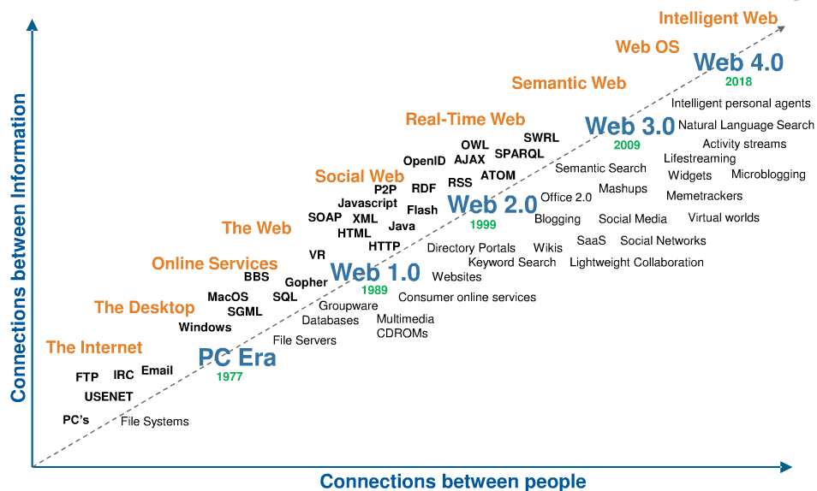
The Intelligence in the Connection

Slide 13


How do people communicate?
Medium
&
Shared vocabulary

Slide 14


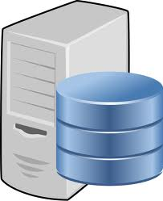
How does software communicate?
Request
Java
…
.NET
…
Mobile
…
Desktop
…
Client
Server
Response
Confidential

Slide 15
Web service definition
W3C Definition
Wikipedia
"Web Service is a software application identified by a URI, whose interfaces and bindings are capable of being defined, described, and discovered by XML artifacts and which supports direct interactions with other software applications using XML-based messages via internet-based protocols".
A Web service is a method of communication between two electronic devices over a network. It is a software function provided at a network address over the Web with the service always on as in the concept of utility computing.
Vangie Beal
The term Web services describes a standardized way of integrating Web-based applications using the XML, SOAP, WSDL and UDDI open standarts over an Internet protocol backbone

Slide 16
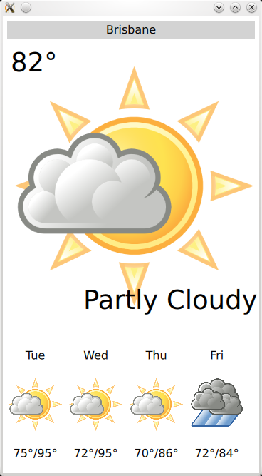

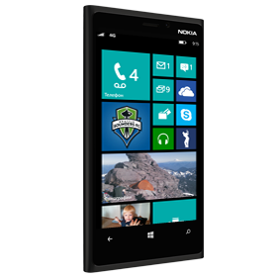

Web Service – type of usage
Reusable application-components.
There are things applications need very often. So why make these over and over again?
Web services can offer application-components like: currency conversion, weather reports, or even language translation as services.
Connect existing software.
Web services can help to solve the interoperability problem by giving different applications a way to link their data.
With Web services you can exchange data between different applications and different platforms.

Slide 17
World Wide Web
The Web as defined by Tim Berners-Lee consists of three elements:
URI (Uniform Resource Identifier) - The way of uniquely identifying resources on the network.
HTML (HyperText Markup Language) - The content format of resources to be returned.
HTTP (HyperText Transfer Protocol) - The protocol used to request a resource from the network and respond to requests.
HTTP methods
All client server communication on the World Wide Web are done using the following simple HTTP methods:

Slide 18
World Wide Web
The Web as defined by Tim Berners-Lee consists of three elements:
URI (Uniform Resource Identifier) - The way of uniquely identifying resources on the network.
HTML (HyperText Markup Language) - The content format of resources to be returned.
HTTP (HyperText Transfer Protocol) - The protocol used to request a resource from the network and respond to requests.
HTTP methods
All client server communication on the World Wide Web are done using the following simple HTTP methods:
GET = "give me some info" (Retrieve)
POST = "here's some info to update” (Update)
PUT = "here's some new info" (Create)
DELETE = "delete some info" (Delete)

Slide 19
Types of Web Services
Service-oriented
Resource-oriented
Based on “services”
One service offered multiple functionalities
“Big” Web Services
SOAP
Based on “resources”
REST

Slide 20
REST &WADL

Slide 21
REST
REST = REpresentational State Transfer
Architectural style in which clients and servers exchange representations of resources by using a standardized interface and protocol.
Principles of REST:
Addressability (URI)
Interface Uniformity (HTTP)
Statelessness (HTTP)
Connectedness (Hypermedia)
Notes:
Paraphrased from Wikipedia:
The REST architectural style describes six constraints applied to the architecture:
Uniform interface
This is the API of the web service, describing operations and data structures.
It simplifies and decouples the architecture of both client and server, enabling each to evolve independently.
Client–server decoupling
Clients are separated from servers by a uniform interface.
For portability, clients must not concern themselves with data storage.
For simplicity and scalability, servers must not concern themselves with the UI or user state.
Servers and clients may be replaced and developed independently, as long as the interface is not altered.
Stateless
No client context should be store on the server between requests.
Each request contains all of the information necessary to service the request and session state is held in the client.
The server can be stateful, but server-side state must be addressable by URL as a resource.
This makes servers:
More scalable.
More visible for monitoring.
More reliable in the event of partial network failures
Cacheable
Clients may cache responses, so responses must define whether they are cachable to prevent clients reusing stale or inappropriate data in response to further requests.
Well-managed caching can eliminate repetitive client–server interactions, further improving scalability and performance.
Layered system
A client’s connection to a server may pass directly to the service or through several intermediaries, allowing:
Scalability by enabling load balancing and by providing shared caches
The enforcement of security policies.
Code on demand (optional)
Servers may temporarily extend or customize the functionality of a client by transferring logic to be executed. (e.g. client-side JavaScript)
If a service violates any constraint other than “code on demand”, it cannot strictly be referred to as REST web service. Complying with these constraints, and thus conforming to the REST architectural style, will improvie a service’s
Performance
Scalability
Simplicity
Modifiability
Visibility
Portability

Slide 22
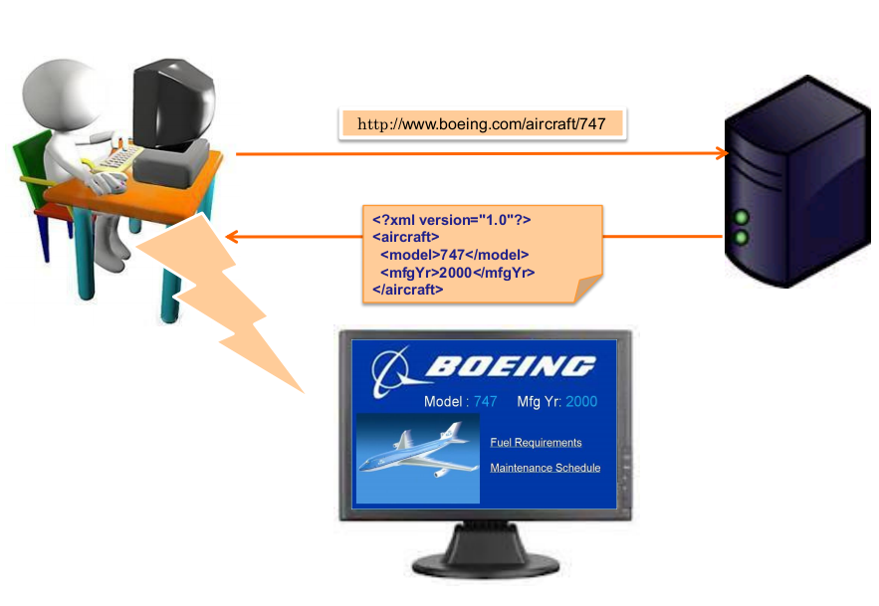
Representation State Transfer

Slide 23
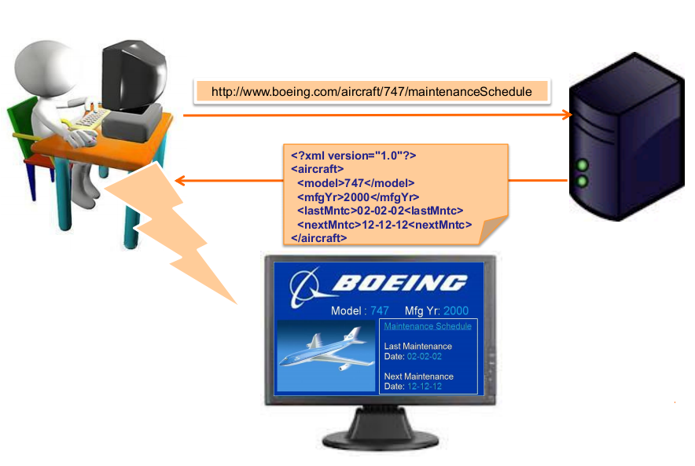
Representation State Transfer

Slide 24
Representation State Transfer
Why is it called "Representational State Transfer?"
1. The Client references a Web resource using a URL.
2. A representation of the resource is returned.
3. The representation (e.g., Boeing747.html) places the client in a new state.
4. When the client selects a hyperlink in Boeing747.html, it accesses another resource.
5. The new representation places the client application into yet another state.
6. Thus, the client application transfers state with each resource representation.

Slide 25
Representation
XML
<COURSE>
<ID>CS2650</ID>
<NAME>Distributed Multimedia Software</NAME>
</COURSE>
JSON
{course
{id: CS2650}
{name: Distributed Multimedia Sofware}
}

Slide 26
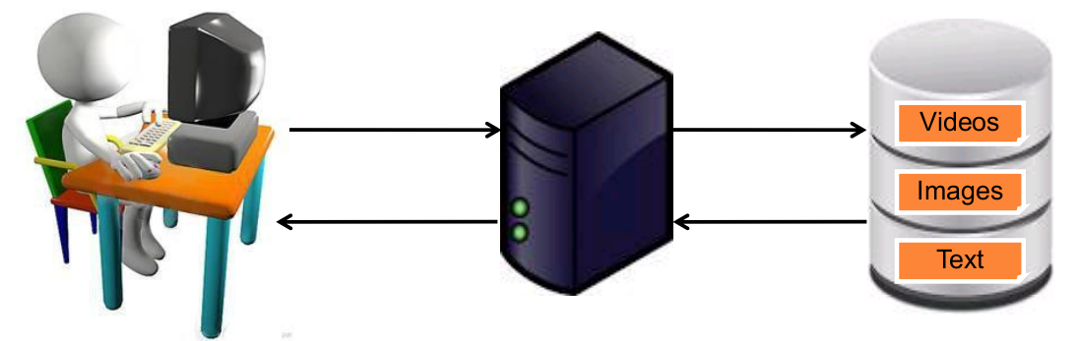
Resource-oriented Web services
Resources
A resource may be a Web site, an HTML page, an XML document, a Web service, an image, a video etc.
URIs - Every resource is uniquely
identified by a URI.
Resource lifecycle management using
HTTPmethods
CRUD | HTTP method
Create | PUT or POST
Read | GET, HEAD or OPTIONS
Update | POST
Delete | DELETE
Notes:
HTTP Methods:
GET – The same request URL should return the same resource every time. The request URL should represent a web resource.
POST – A generic method for submitting information to the service. The outcome is defined by the service. The request URL need not represent a web resource.
PUT – Adds a new resource at the request URL. The resource should then be available through a GET request using the same request URL.
DELETE – Removes the resource at the request URL. The resource should no longer be available via a GET request at that URL.
OPTIONS – Indicates which HTTP methods are supported at the request URL. Useful for identifying
HEAD – Same as GET but only returns meta-information about the resource. The response body will be empty. Useful for requesting information about a resource without having to request the resource itself.
Other HTTP verbs are NOT typically supported in a REST service.
The above guidelines are required if you wish to remain compliant with the HTTP specification
Actual usage of HTTP verbs may vary from implementation to implementation.
When producing a service for consumption by a third-party, it is recommended that the service adhere to the HTTP specification
Difference between POST and PUT:
“The fundamental difference between the POST and PUT requests is reflected in the different meaning of the Request-URI. The URI in a POST request identifies the resource that will handle the enclosed entity. That resource might be a data-accepting process, a gateway to some other protocol, or a separate entity that accepts annotations. In contrast, the URI in a PUT request identifies the entity enclosed with the request -- the user agent knows what URI is intended and the server MUST NOT attempt to apply the request to some other resource. If the server desires that the request be applied to a different URI, it MUST send a 301 (Moved Permanently) response; the user agent MAY then make its own decision regarding whether or not to redirect the request.” – Emphasis added, W3C HTTP Method specification, referenced at end of presentation
Methods Naving No Request Body:
GET, DELETE, OPTIONS, HEAD
Methods Having a Request Body:
POST – body may contain form parameters or other information to be uploaded to the service
PUT – body contains the resource to be represented at the request URL
Methods Supplying No Response Body
HEAD
OPTIONS

Slide 27
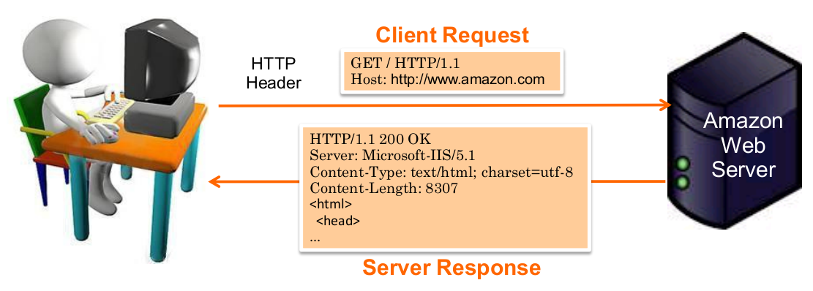
Retrieving information using HTTP GET
The user types http://www.amazon.com in his browser.
The browser software creates and sends a HTTP request with a header that holds:
The desired action: GET ("get me resource")
The target machine (www.amazon.com)
The server responds with the requested resource which is rendered on the browser

Slide 28
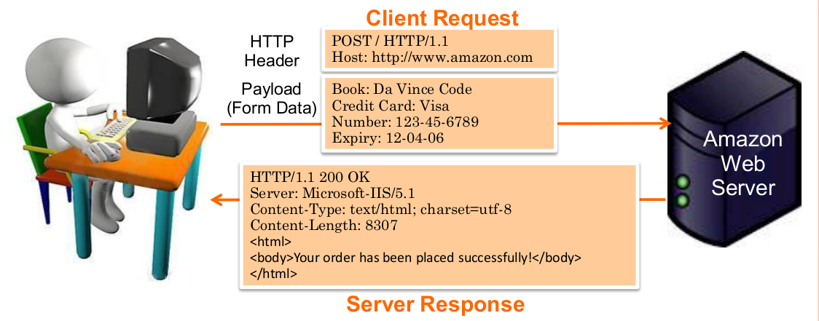
Updating information using HTTP POST
The user fills in a form on the Web page and submits it.
The browser software creates and send a HTTP request with a header and a payload comprising of the form data.
The HTTP header identifies:
The desired action: POST
The target machine (amazon.com)
The payload contains:
The data being POSTed (the form data)
The server responds with the requested resource which is rendered on the browser .

Slide 29
HTTP-REST Request Basics
The HTTP request is sent from the client.
Identifies the location of a resource.
Specifies the verb, or HTTP method to use when accessing the resource.
Supplies optional request headers (name-value pairs) that provide additional information the server may need when processing the request.
Supplies an optional request body that identifies additional data to be uploaded to the server (e.g. form parameters, attachments, etc.)
Notes:
Resource – identified by a URL (or uniform resource locator)
Method – the action verb to perform on a resource
e.g. GET, POST, PUT, DELETE, etc.
Request Headers – name-value pairs of meta-information about the request
e.g. Content types expected by the client
Request Body – data to be streamed from the client to the server
e.g. Attachments, form parameters, etc.

Slide 30
HTTP-REST Request Basics
Sample Client Requests:
A typical client GET request:
A typical client POST request:
Requested Resource (path and query string)
GET /view?id=1 HTTP/1.1
User-Agent: Chrome
Accept: application/json
[CRLF]
Request Headers
(no request body)
Requested Resource (typically no query string)
POST /save HTTP/1.1
User-Agent: IE
Content-Type: application/x-www-form-urlencoded
[CRLF]
name=x&id=2
Request Headers
Request Body (e.g. form parameters)
Notes:
Note: A REST web service may return the representation of a resource in many formats (HTML, XML, JSON, binary).
It is the client’s responsibility to use the “Accept” request header to identify the expected content type of the returned resource.

Slide 31
HTTP-REST Response Basics
The HTTP response is sent from the server.
Gives the status of the processed request.
Supplies response headers (name-value pairs) that provide additional information about the response.
Supplies an optional response body that identifies additional data to be downloaded to the client (html, xml, binary data, etc.)
Notes:
Status – An HTTP status code and status message
e.g. 404 Not Found, 200 OK
Response Headers – name-value pairs of meta-information about the response
e.g. Content-Type
Response Body – Additional data to be streamed from the server to the client
e.g. HTML document, XML document, binary data

Slide 32
HTTP-REST Response Basics
Sample Server Responses:
HTTP/1.1 200 OK
Content-Type: text/html
Content-Length: 1337
[CRLF]
<html>
<!-- Some HTML Content. -->
</html>
Response Status
Response Headers
Response Body (content)
HTTP/1.1 500 Internal Server Error
Response Status
HTTP/1.1 201 Created
Location: /view/7
[CRLF]
Some message goes here.
Response Status
Response Header
Response Body

Slide 33
HTTP-REST Vocabulary
http://my.store.com/fruits/list?category=fruit&limit=20
protocol
host name
path to a resource
query string
A typical HTTP REST URL:
The protocol identifies the transport scheme that will be used to process and respond to the request.
The host name identifies the server address of the resource.
The path and query string can be used to identify and customize the accessed resource.

Slide 34
HTTP and REST
A REST service framework provides a controller for routing HTTP requests to a request handler according to:
The HTTP method used (e.g. GET, POST)
Supplied path information (e.g /service/listItems)
Query, form, and path parameters
Headers, cookies, etc.

Slide 35
Resources
The key abstraction of information in REST is a resource.
A resource is a conceptual mapping to a set of entities
Any information that can be named can be a resource: a document or image, a temporal service (e.g. "today's weather in Los Angeles"), a collection of other resources, a non-virtual object (e.g. a person), and so on
Represented with a global identifier (URI in HTTP)
http://www.boeing.com/aircraft/747

Slide 36
Naming resources
REST uses URI to identify resources
http://localhost/books/
http://localhost/books/ISBN-0011
http://localhost/books/ISBN-0011/authors
http://localhost/classes
http://localhost/classes/cs2650
http://localhost/classes/cs2650/students
As you traverse the path from more generic to more specific, you are navigating the data

Slide 37
HTTP GET
How clients ask for the information they seek.
Issuing a GET request transfers the data from the server to the client in some representation
GET http://localhost/books
Retrieve all books
GET http://localhost/books/ISBN-0011021
Retrieve book identified with ISBN-0011021
GET http://localhost/books/ISBN-0011021/authors
Retrieve authors for book identified with ISBN-0011021

Slide 38
HTTP POST, HTTP PUT
HTTP POST creates a resource
HTTP PUT updates a resource
POST http://localhost/books/
Content: {title, authors[], …}
Creates a new book with given properties
PUT http://localhost/books/isbn-111
Content: {isbn, title, authors[], …}
Updates book identified by isbn-111 with submitted properties

Slide 39
HTTP DELETE
Removes the resource identified by the URI
DELETE http://localhost/books/ISBN-0011
Delete book identified by ISBN-0011

Slide 40
WADL
Document
structure

Slide 41
WADL
What is WADL?
Web Application Description Language
XML-based language
Platform neutral
Aligned with REST terminology
WADL is designed to provide a simple alternative to WSDL for use with XML/HTTP applications.

Slide 42

Demo of WADL

Slide 43

Simple
Object
Access
Protocol

Slide 44
Some words about SOAP
stands for Simple Object Access Protocol;
is a communication protocol;
is for communication between applications;
format for sending messages;
communicates via Internet;
platform independent;
language independent;
based on XML;
simple and extensible;
allows you to get around firewalls;
W3C recommendation.
Notes:
SOAP (от англ. Simple Object Access Protocol — простой протокол доступа к объектам; вплоть до спецификации 1.2) — протокол обмена структурированными сообщениями в распределённой вычислительной среде. Первоначально SOAP предназначался в основном для реализации удалённого вызова процедур (RPC). Сейчас протокол используется для обмена произвольными сообщениями в формате XML, а не только для вызова процедур. Официальная спецификация последней версии 1.2 протокола никак не расшифровывает название SOAP.
SOAP может использоваться с любым протоколом прикладного уровня: SMTP, FTP, HTTP, HTTPS и др. Однако его взаимодействие с каждым из этих протоколов имеет свои особенности, которые должны быть определены отдельно. Чаще всего SOAP используется поверх HTTP.
SOAP является одним из стандартов, на которых базируются технологии веб-служб.

Slide 45
Skeleton SOAP message
<?xml version="1.0"?> <soap:Envelope xmlns:soap="http://www.w3.org/2001/12/soap-envelope" soap:encodingStyle="http://www.w3.org/2001/12/soap-encoding"> <soap:Header> ... </soap:Header> <soap:Body> ... <soap:Fault> ... </soap:Fault> </soap:Body> </soap:Envelope>

Slide 46
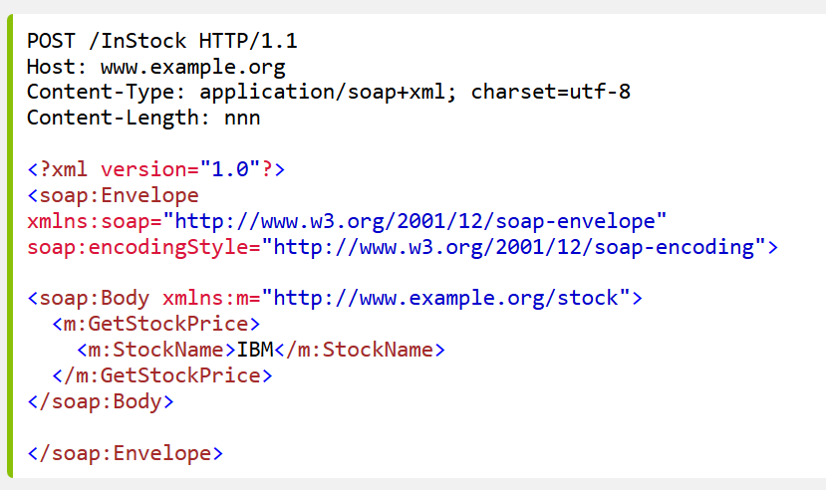
SOAP Request

Slide 47
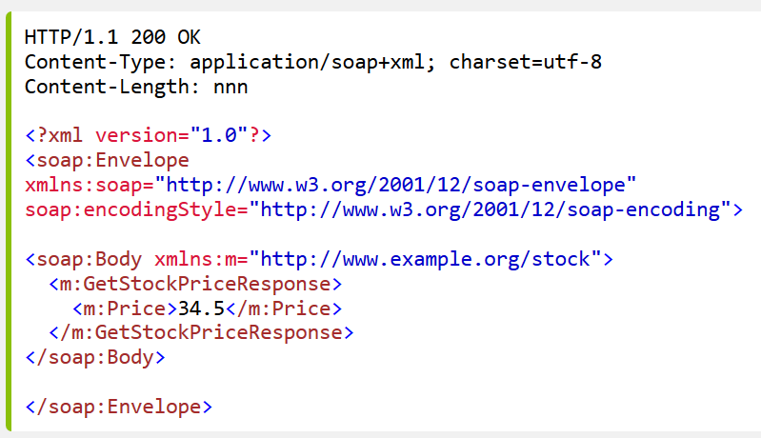
SOAP Response

Slide 48
Web
Services
Description
Language

Slide 49
What is WSDL?
Web Service Description Language.
An XML language used to describe and locate web services.
Written in XML.
Describe functionality of a web service
Specify how to access the service (binding protocol, message format, and etc.)
Not a W3C standard yet.
Version 1.1 released March 2001
Working draft of Version 1.2 released July 2003, but later renamed to WSDL 2.0 due to the many changes from WSDL 1.1

Slide 50
Example WSDL Document

Slide 51
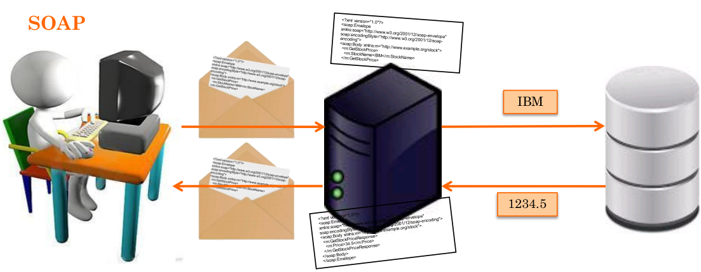
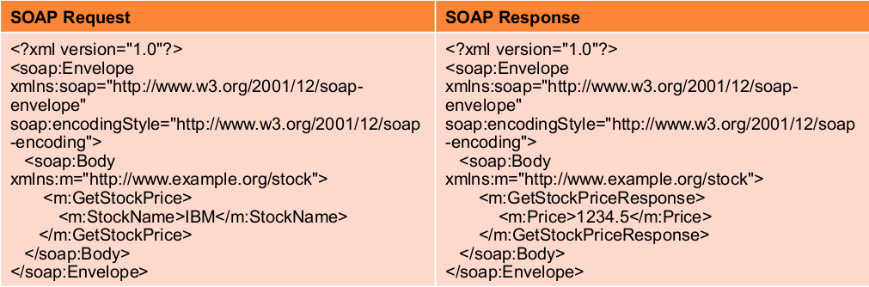
Soap vs RESTful Web Services

Slide 52
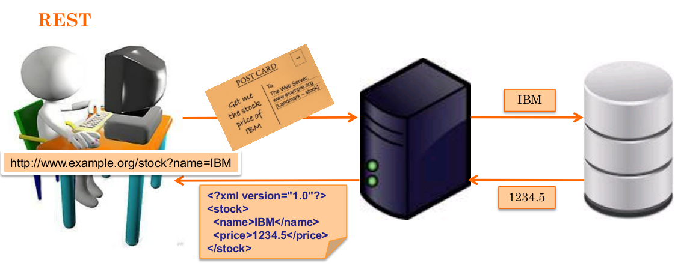
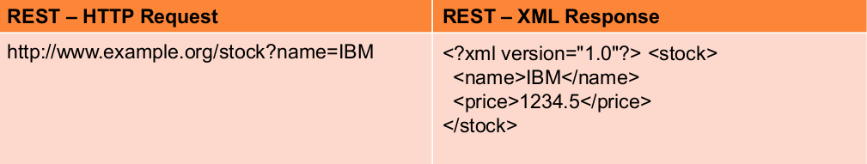
Soap vs RESTful Web Services

Slide 53
Fiddler

Slide 54
How does software communicate?
Request
Java
…
.NET
…
Mobile
…
Desktop
…
Client
Server
Response
Confidential

Slide 55
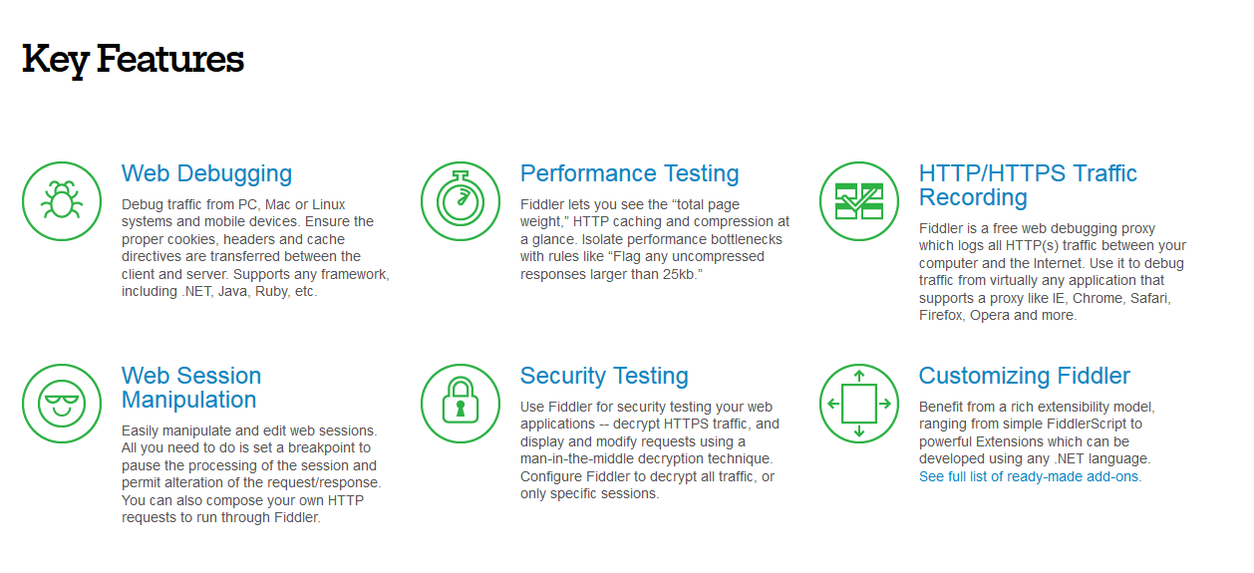
What is Fiddler?

Slide 56
Soap UI

Slide 57
What is tested usually?
Status codes
Data
Data type
Data order
Fullness
Negative cases
Response timeouts

Slide 58

Some fact about Soap UI
Free, open source desktop application for inspecting, invoking, developing, mocking and testing of web services over HTTP.
The world's leading Functional Testing tool for SOA and Web Service testing
More then 50000 users
More then 1000 Daily Downloads
Cross-platform

Slide 59
Intro into Soap IU basics
Soap UI provides you the possibility of creation automated
Functional tests
Load tests
Service Simulation tests
Security tests

Slide 60
Automated Functional tests in Soap UI
Soap UI provides support for Functional Testing all the common standards and technologies:
HTTP(S)
HTML
SOAP/WSDL
REST
AMF
JDBC
JMS
Creation of complex scenarios at once and easily
Groove is used as for advanced scripting steps
Data-Driven Testing approach can be applied
Analysis of Test Coverage

Slide 61

What is inside Soap UI?

Slide 62
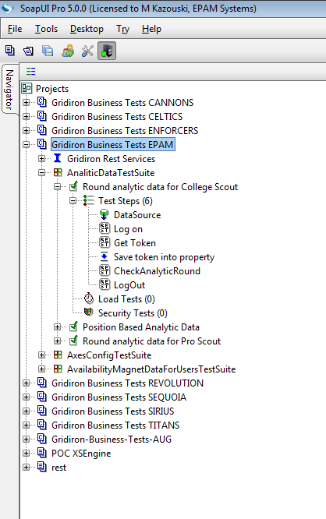
General view of Soap UI
project
service methods
test suite
test case
step

Slide 63
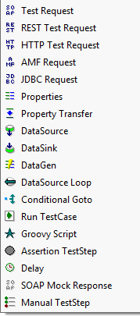
Steps of test
Mostly used test
steps in testing WSs

Slide 64
How to create Test Case in Soap UI?
Create project
Import WADL/WSDL or create endpoints manually
Create Test Suite
Create Test Case
Add steps
Add assertions

Slide 65
Getting started - Demo of usage Soap UI
Notes:
Install Soap UI Pro on your PC
Base test scenario

Slide 66
IDE plugins & SoapUI
SoapUI IDE plugins exists for:
Eclipse
NetBeans
IDEA

Slide 67
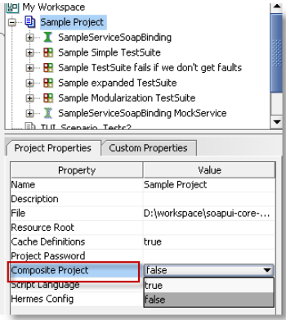
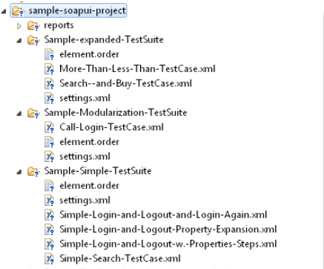
VCS & SoapUI
Setting this property to true and saving the project will convert the single file project into a folder structure
And then you could use your favorite VCS

Slide 68
CI & SoapUI
Ant
Maven
Jenkins
Bamboo
Hudson

Slide 69
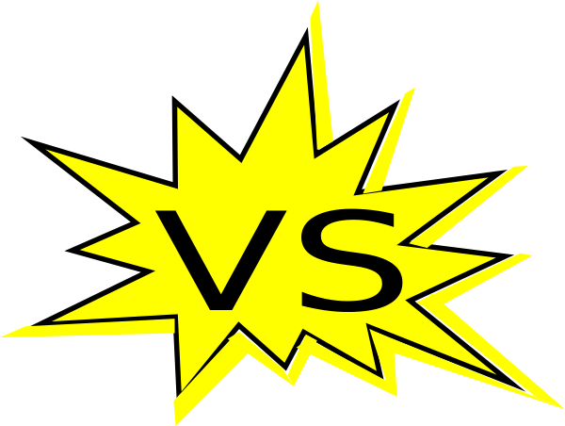
SoapUI vs SoapUI Pro
SoapUI Pro provides the following possibilities:
Use Data Sources
A lot of functionalities of assertion’s creation and editing
Calculate test coverage
Test debugging
Support of multi-environments
Reporting
SQL builder
Refactoring
Collaborative usage

Slide 70
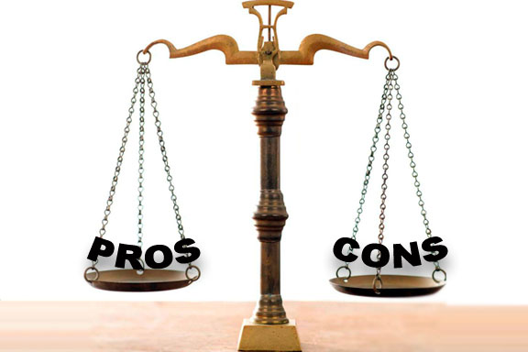
Pros and cons of usage Soap UI
1. Easy to start and effectively use
2. A lot of functionalities
3. Wide support for different protocols
4. Demonstrative
5. Integration with other tools
6. Ongoing support
7. Free version exists
1. You have to pay for Pro version. Free version has greatly curtailed functionality
2. Not so flexible as custom solution
3. From practice – bugs are fixed not so quickly
4. From practice – sometimes it is buggy
Notes:
To discuss.

Slide 71
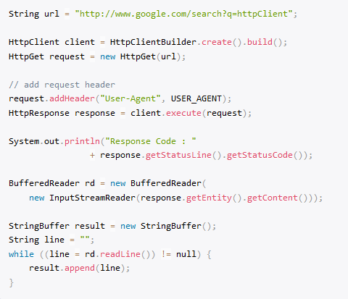
Java-based approaches – Apache HTTP Client

Slide 72
High level architecture
Client
POJOs
Tests

Slide 73
Murshalling - unmurshalling
Data
String
Complex Data
Short
<?xml version="1.0">
<Data>
<complexData>
<payload>
Some complex content here
</payload>
</complexData>
<string>Text</string>
<basicType>42</basicType>
</Data>
public class Data {
ComplexData complexData = new ComplexData ();
String string = "Text";
short basicType = 42;
}

Slide 74
Murshalling - unmurshalling
<?xml version="1.0"> <sample>
<!–– Complex node -->
<complexData> <payload>
Some complex content here
</payload> </complexData>
<!–– Simple string node ––>
<string>Text</string>
<!-- Simple number node -->
<basicType>42</basicType>
</sample>
public class SampleType {
ComplexType complexData; String string; short basicType;
public ComplexType getComplexData() {return complexData;}
public void setComplexData( ComplexType value ) {complexData = value;}
public String getString() {return string;}
public void setString( String value) {this.string = value;}
...

Slide 75
Rest-assured
REST Assured is a Java DSL for simplifying testing of REST based services built on top of HTTP Builder.
It supports POST, GET, PUT, DELETE, OPTIONS, PATCH and HEAD requests and can be used to validate and verify the response of these requests.

Slide 76
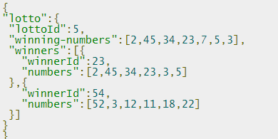
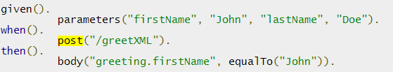
Rest Assured – how it works?

Slide 77

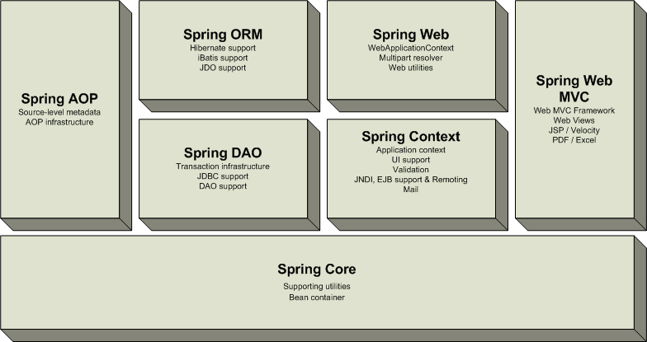
Spring – what is it?
Notes:
Spring Framework (или коротко Spring) — универсальный фреймворк с открытым исходным кодом для Java-платформы. Также существует форк для платформы .NET Framework, названный Spring.NET^{[2]}.
Spring Framework может быть рассмотрен как коллекция меньших фреймворков или фреймворков во фреймворке. Большинство этих фреймворков может работать независимо друг от друга, однако они обеспечивают большую функциональность при совместном их использовании. Эти фреймворки делятся на структурные элементы типовых комплексных приложений:
Inversion of Control-контейнер: конфигурирование компонентов приложений и управление жизненным циклом Java-объектов.
Фреймворк аспектно-ориентированного программирования: работает с функциональностью, которая не может быть реализована возможностями объектно-ориентированного программирования на Java без потерь.
Фреймворк доступа к данным: работает с системами управления реляционными базами данных на Java-платформе, используя JDBC- и ORM-средства и обеспечивая решения задач, которые повторяются в большом числе Java-based environments.
Фреймворк управления транзакциями: координация различных API управления транзакциями и инструментарий настраиваемого управления транзакциями для объектов Java.
Фреймворк MVC: каркас, основанный на HTTP и сервлетах, предоставляющий множество возможностей для расширения и настройки (customization).
Фреймворк удалённого доступа: конфигурируемая передача Java-объектов через сеть в стиле RPC, поддерживающая RMI, CORBA, HTTP-based протоколы, включая web-сервисы (SOAP).
Фреймворк аутентификации и авторизации: конфигурируемый инструментарий процессов аутентификации и авторизации, поддерживающий много популярных и ставших индустриальными стандартами протоколов, инструментов, практик через дочерний проект Spring Security (ранее известный как Acegi).
Фреймворк удалённого управления: конфигурируемое представление и управление Java-объектами для локальной или удалённой конфигурации с помощьюJMX.
Фреймворк работы с сообщениями: конфигурируемая регистрация объектов-слушателей сообщений для прозрачной обработки сообщений из очереди сообщений с помощью JMS, улучшенная отправка сообщений по стандарту JMS API.
Тестирование: каркас, поддерживающий классы для написания модульных и интеграционных тестов.

Slide 78



References
http://www.springsource.org/spring-framework

Slide 79
RestTemplate
RestTemplate is the central Spring class for client-side HTTP access.

Slide 80
RestTemplate Methods
HTTP | RestTemplate
DELETE | delete(String, String...)
GET | getForObject(String, Class, String...)
HEAD | headForHeaders(String, String...)
OPTIONS | optionsForAllow(String, String...)
POST | postForLocation(String, Object, String...)
PUT | put(String, Object, String...)
Notes:
The names of these methods clearly indicate which HTTP method they invoke, while the second part of the name indicates what is returned. For instance, getForObject() will perform a GET, convert the HTTP response into an object type of your choice, and returns that object. postForLocation will do a POST, converting the given object into a HTTP request, and returns the response HTTP Location header where the newly created object can be found. As you can see, these methods try to enforce REST best practices.

Slide 81
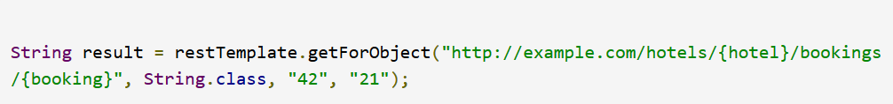
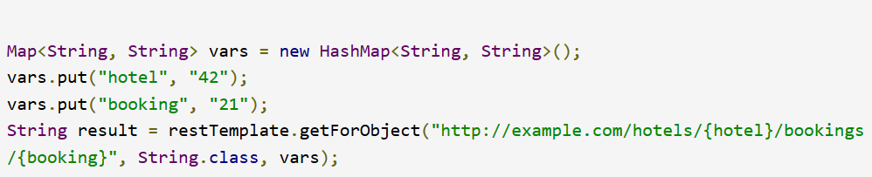
URI Templates
Notes:
Each of these methods takes a URI as first argument. That URI can be a URI template, and variables can be used to expand the template to a normal URI. The template variables can be passed in two forms: as a String variable arguments array, or as a Map<String, String>. The string varargs variant expands the given template variables in order, so that … will perform a GET on http://example.com/hotels/42/bookings/21. The map variant expands the template based on variable name, and is therefore more useful when using many variables, or when a single variable is used multiple times. For example: …

Slide 82

What we learnt for the whole course?

Slide 83
Types of Web Services
Service-oriented
Resource-oriented
Based on “services”
One service offered multiple functionalities
SOAP
Based on “resources”
REST
Notes:
Пример:
Ресурс-ориентированный – Сайт для мерседеса – нам нужно получать информацию о машинах, администратор может добавить какие-то новые машины, редактировать существующие или удалять их.
А вот другой пример:
Нам нужно написать приложение, которое будет позволять нам работать со складом медикаментов. Тут уже сложнее – передавая новую продукцию нужно проверять, нужен ли этот продукт, хватит ли места на складе, чтобы поставить эту продукцию, подходить ли нам срок этой продукции и т.д. - Лишь после этого клиенту приходит ответ об успешности операции. Здесь явно прослеживается ориентация на операции, имеются повышенные требования к безопасности и устойчивости приложения, поэтому целесообразно использовать SOAP, транзакции, сложная логика.

Slide 84
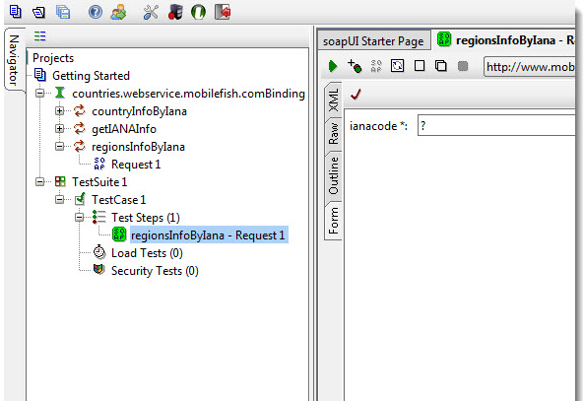
What was learnt for today?
Main features an functionalities

Slide 85
Creation of simple test
Create the Client with base url that you wanted.
Create Requests
Run created requests using Client
Get Response and verify it

Slide 86

Thank you for your attention!
Anastasiya Babovich Anastasiya_Babovich@epam.com

